Slide 1
eProcurement ontology
8th Working group meeting
Natalie Muric
12 February 2019
Luxembourg

Slide 2
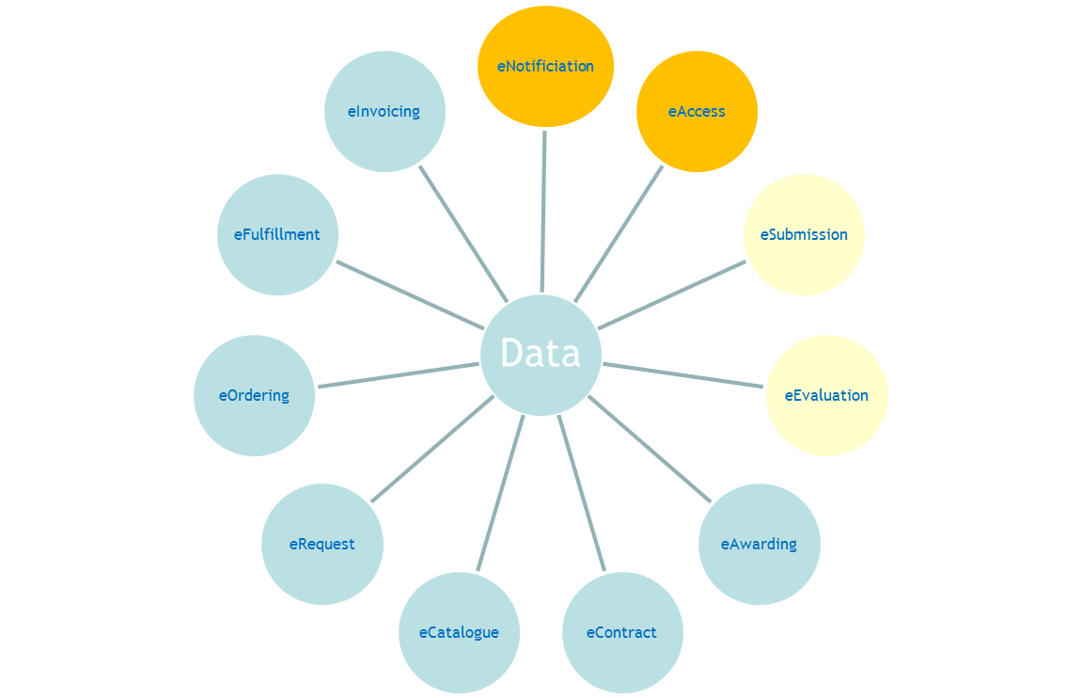
Back to basics
The ontology is about data and not processes
Data collection is carried out in phases
The conceptual model is split into bite-size models
The overview model brings together all the different models
The phases and models are independent of each other

Slide 3
Important points
eNotification provides a backbone of data as it gathers information from different phases
the different conceptual models at this point are only as complete as necessary for eNotification and eAccess
eNotification has had to draw a lot from eEvaluation
Slowing the eNotification phase
Hopefully speeding up work on the eEvaluation phase
Each phase consolidates previous phases
Work on eNotification is in parallel with eForm consultations
See: https://github.com/eForms/eForms
Notes:
e

Slide 4
Conceptual data model v.2.0.1 eNotification & eAccess content
Reviewed
Project procurement
Procedure
Accelerated procedure
Lots
Instrument and techniques
Buyer replacing Procuring entity
Criterion
Procurement criterion
Tender
Evaluation result
Procurement terms
Economic operator
To be reviewed
Overview
Contract
Documents
Contract award notice
Data types

Slide 5
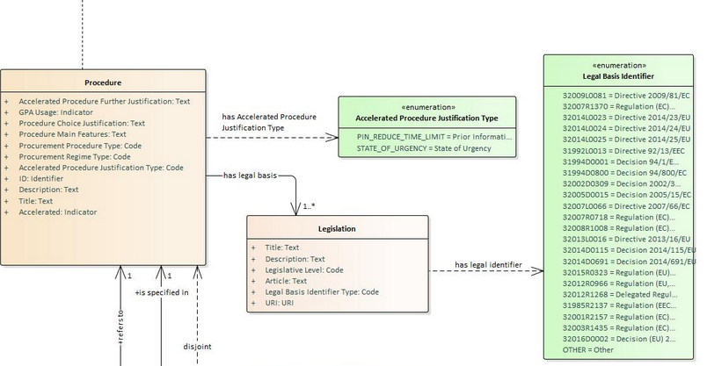
Code lists & taxonomies
Business agnostic
Not related to the procurement domain
For example: countries, currencies, languages, etc.
Business domain specific
Related to the procurement domain
Can be used for any phase of eProcurement
Examples: accelerated-procedure-justification, legal-basis- identifier
Application specific
Related to the visualisation of content

Slide 6
The next two days eEvaluation & eSubmission data requirements
Let’s get to know each other
Share our experiences
Work as a team to:
Identify the data requirements for eEvaluation & eSubmission
Extend the current conceptual models

Slide 7
The road ahead
Continue twice weekly conference calls
https://ecwacs.webex.com/meet/nmuric
Current time slots Proposed future time slots
Tuesday’s 14:00-16:00 Tuesday’s 14:00-16:00
Wednesdays 14:00-16:00 Thursdays 15:00-17:00
2 day Face-Face meeting April – May 2019
Finalise eNotification & eAccess before summer 2019
Finalise eSubmission & eEvaluation autumn 2019
Start work on other phases from autumn 2019

Slide 8
The eProcurement Ontology Working group
Links
On github: https://github.com/eprocurementontology/eprocurementontology/wiki
On join-up:
https://joinup.ec.europa.eu/solution/eprocurement-ontology/about
Contact us at:
OP-EPROCUREMENT-ONTOLOGY@publications.europa.eu
Natalie.muric@pubications.europa.eu

Slide 9
Let’s create the eProcurement ontology together
everis
France
AGID
OCP
Consip
APMEP
EBRD
DG GROW
OP
Difi
DIGIT
CEN TC 434
ANAC
Quintagroup

